Slide 1
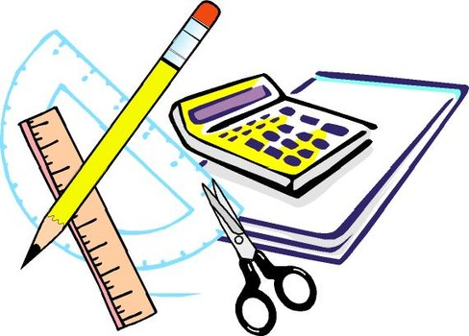
Learning Objective
I will expand and simplify algebraic expressions.
Enter quietly, please be ready with the following on your desk:
Whiteboard
Whiteboard marker
Exercise Book
Pencil, pen, ruler and red pen
Diary
Calculator
Device – charged or borrowed from Library before maths

Slide 2
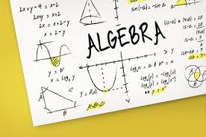
Learning Objective
CFU
What will we learn today?
CFU
I will expand and simplify algebraic expressions.
How will you know that you are successful?
Success Criteria
At the end of the lesson, I will be able to:
Expand algebraic expressions by multiplying out the brackets using the array method.

Slide 3
Activate Prior Knowledge
Distributive law – we split large numbers into 1s, 10s and 100s
15 x 9
9 is a small number so we leave it as it is
15 is a large number so we split it into 10 + 5
9 x (10 + 5)
9 x 10 + 9 x 5
90 + 45
= 135

Slide 4



Concept Development
When expanding brackets we want to get rid of the brackets.
The Distributive Law helps us do this.
5(y + 2) is
5 $×$y + 5 $×$ 2 = 5y + 10
What would 4($2x$ + 4) be?
4 $×2x$ + 4 $×$ 4 = 8$x$ + 16

Slide 5


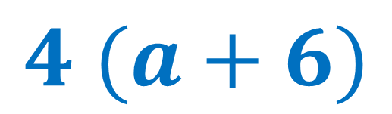
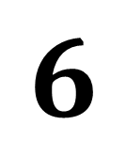

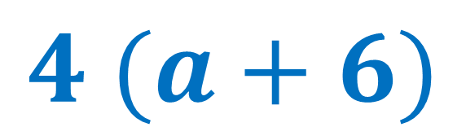
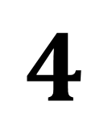
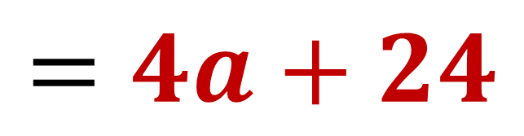
Skill Development / Guided Practice
$$4 (a+6)$$
$$4 lots of (a+6)$$
$$a$$
$$6$$
$$4 (a+6)$$
$$=4a+24$$
$$4$$
$$4a$$
$$24$$

Slide 6


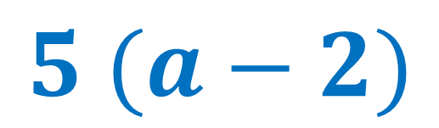
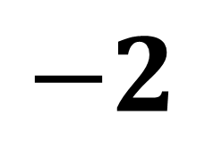
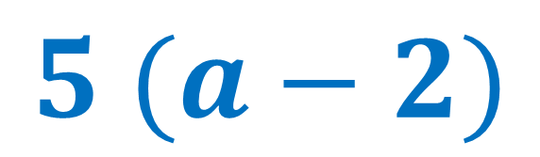


Skill Development / Guided Practice
$$5 (a−2)$$
$$5 lots of (a−2)$$
$$a$$
$$−2$$
$$5 (a−2)$$
$$=5a−10$$
$$5$$
$$5a$$
$$−10$$

Slide 7


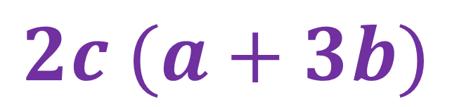
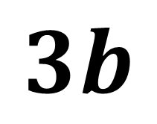


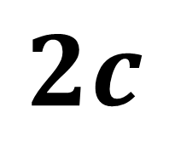

Skill Development / Guided Practice
$$2c (a+3b)$$
$$2c lots of (a+3b)$$
$$a$$
$$3b$$
$$2c (a+3b)$$
$$2c$$
$$2ac$$
$$6bc$$
$$=2ac+6bc$$

Slide 8


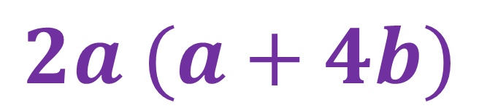
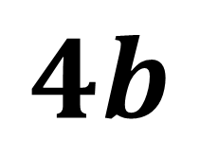

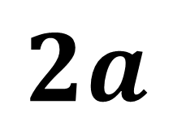

Skill Development / Guided Practice
$$2a (a+4b)$$
$$2a lots of (a+4b)$$
$$a$$
$$4b$$
$$2a (a+4b)$$
$$2a$$
$$2a2$$
$$8ab$$
$$=2a2+8ab$$

Slide 9


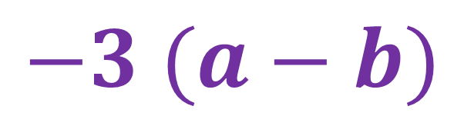
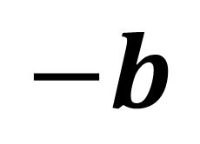
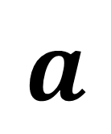

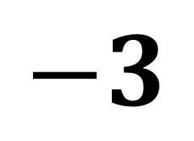

Skill Development / Guided Practice
$$−3 (a−b)$$
$$−3 lots of (a−b)$$
$$a$$
$$−b$$
$$−3 (a−b)$$
$$−3$$
$$−3a$$
$$3b$$
$$=−3a+3b$$

Slide 10


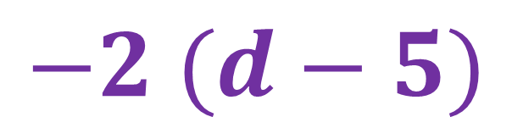
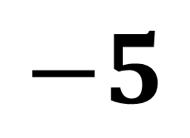
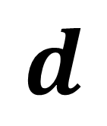

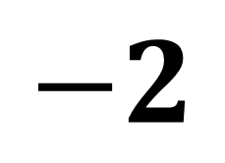
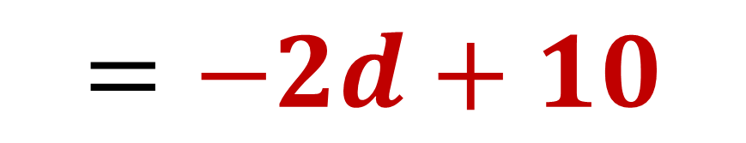
Skill Development / Guided Practice
$$−2 (d−5)$$
$$−2 lots of (d−5)$$
$$d$$
$$−5$$
$$−2 (d−5)$$
$$−2$$
$$−2d$$
$$10$$
$$=−2d+10$$

Slide 11


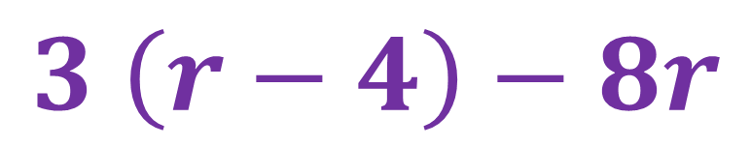
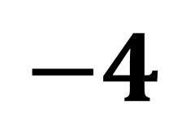
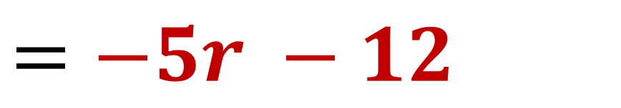



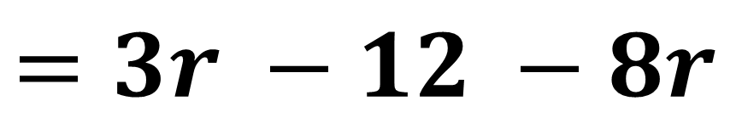
Skill Development / Guided Practice
$$3 \left(r−4\right)−8r$$
$$3 lots of \left(r−4\right), then take away 8r$$
$$r$$
$$−4$$
$$3 \left(r−4\right)−8r$$
$$=3r −12 −8r$$
$$3$$
$$3r$$
$$−12$$
$$=−5r −12$$

Slide 12






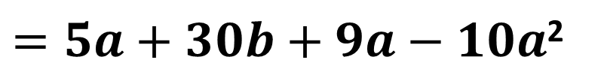
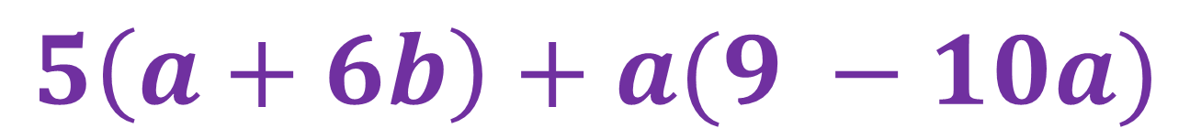









Skill Development / Guided Practice
$$5\left(a+6b\right)+a(9 −10a)$$
$$a$$
$$6b$$
$$5\left(a+6b\right)+a(9 −10a)$$
$$9$$
$$−10a$$
$$5$$
$$5a$$
$$30b$$
$$=5a+30b+a(9 −10a)$$
$$a$$
$$9a$$
$$−10a2$$
$=5a+30b+9a−10a$²
$$5a+30b$$
$$9a−10a2$$
$=14a+30b−10a$²

Slide 13
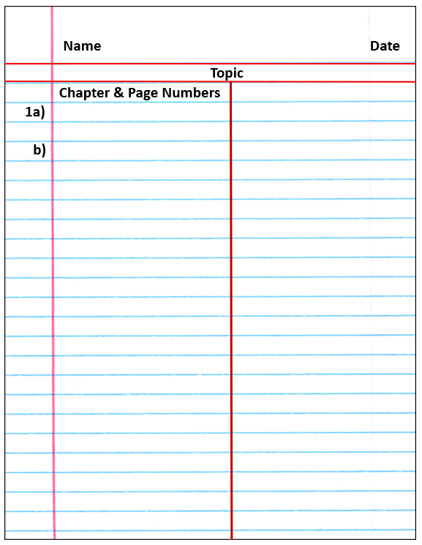
Independent Practice
Mathematics Page Layout
Pearson 10 – Ex 3.1 page 154 Question 1
Mathspace task – Year 10 Mainstream Expanding Brackets CLASSWORK

